Slide 1


Predict Clicked Ads Customer Classification by using Machine Learning
Created by:
Fairuz Nur Indah Putri
fnputri31@gmail.com
https://www.linkedin.com/in/fairuz-nur-indah-p/
An Engineering Graduate that highly motivated about learning new things to improve my skills, especially in machine learning, quantitative analytics, and statistics. I am currently interested in working in the data field, especially being a data scientist. I have experience in using Python, R Programming, and SQL and have several machine learning projects that I have worked on including supervised, unsupervised, product recommendation, forecasting, and deep learning with tensorflow.

Slide 2
Overview
“A company in Indonesia wants to know the effectiveness of an advertisement that they run, this is important for the company so that they can find out how much achievement the advertisements marketed so that they can attract customers to see advertisements.
By processing historical advertisement data and finding insights and patterns that occur, it can help companies determine marketing targets, the focus of this case is to create machine learning classification models that function to determine the right target customers "

Slide 3
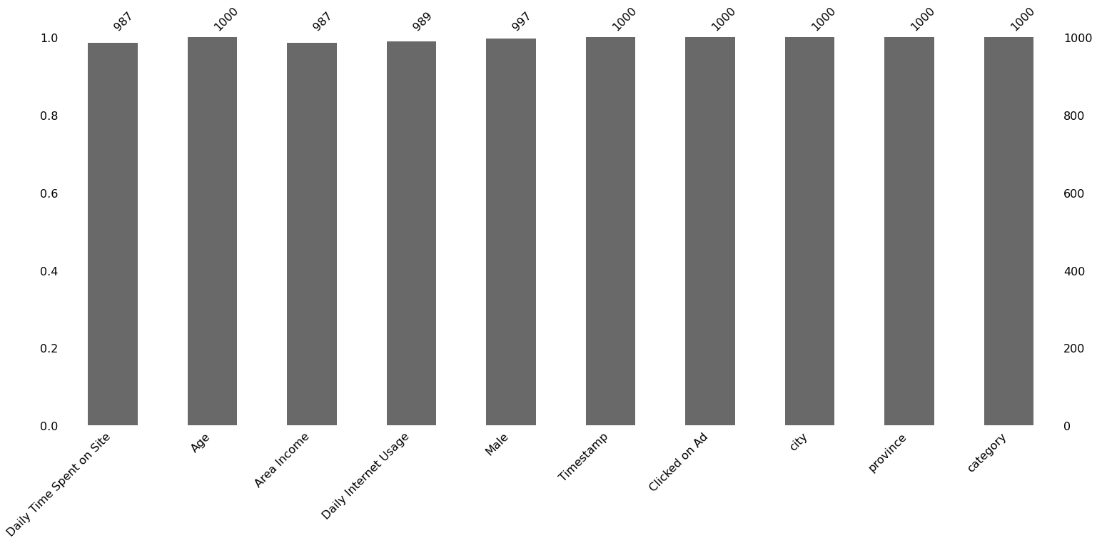
EXPLONATORY DATA ANALYSIS
a. Missing Value
Untuk selengkapnya, dapat melihat jupyter notebook disini

Slide 4
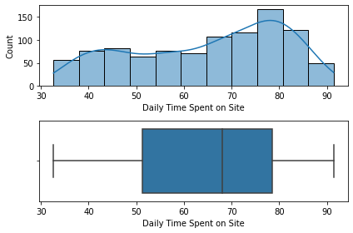
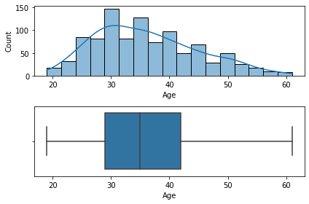
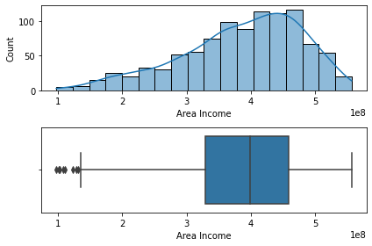
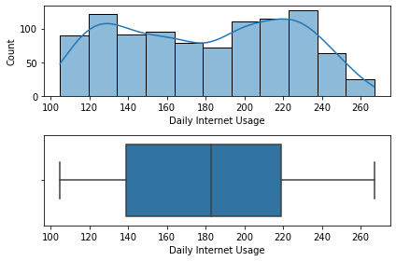
EXPLONATORY DATA ANALYSIS
b. Univariate - Numeric
Untuk selengkapnya, dapat melihat jupyter notebook disini

Slide 5
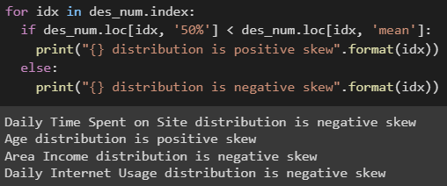
EXPLONATORY DATA ANALYSIS
b. Univariate - Numeric
Untuk selengkapnya, dapat melihat jupyter notebook disini

Slide 6
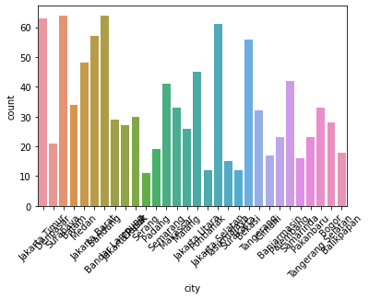
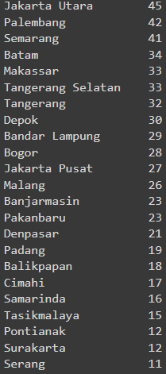
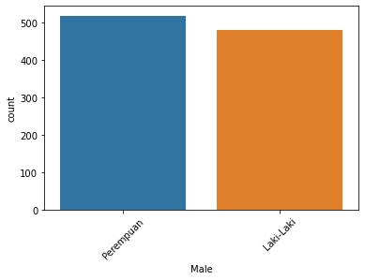
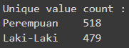
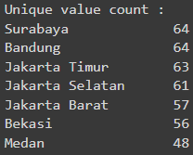
EXPLONATORY DATA ANALYSIS
c. Univariate - Category
Untuk selengkapnya, dapat melihat jupyter notebook disini

Slide 7
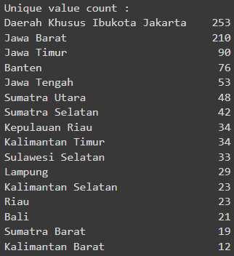
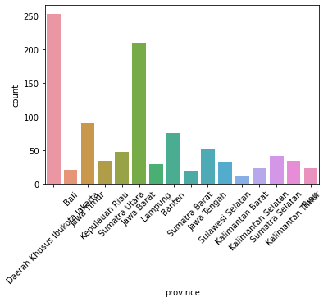
EXPLONATORY DATA ANALYSIS
c. Univariate - Category
Untuk selengkapnya, dapat melihat jupyter notebook disini

Slide 8
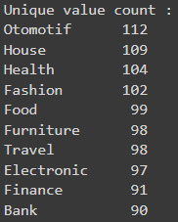
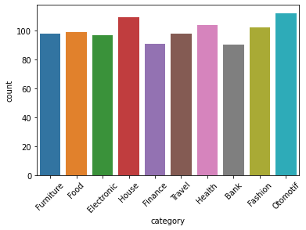
EXPLONATORY DATA ANALYSIS
c. Univariate - Category
Untuk selengkapnya, dapat melihat jupyter notebook disini

Slide 9
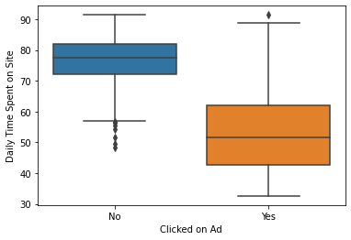
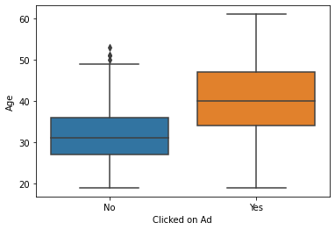
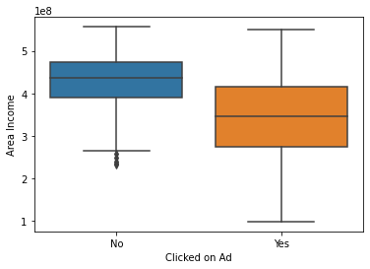
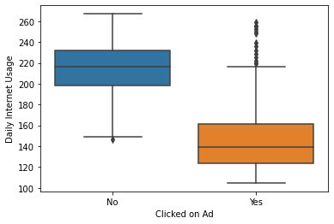
EXPLONATORY DATA ANALYSIS
d. Bivariate Num - Label
Untuk selengkapnya, dapat melihat jupyter notebook disini

Slide 10
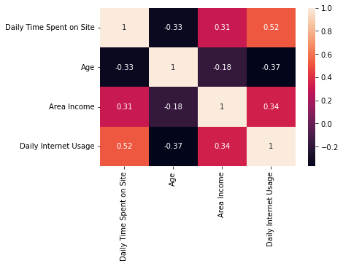
EXPLONATORY DATA ANALYSIS
e. Bivariate Num - Label
Untuk selengkapnya, dapat melihat jupyter notebook disini

Slide 11
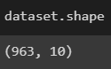
Data Preprocessing
1. Change the range of `Age` to teen age (17 - 25), mid age (26 - 45), eldery (46 - 65)
2. Extract weekday from `Timestamp` and if weekday = 1 and not weekday 0
3. Change the column name `Male` to Gender
After dropna
Untuk selengkapnya, dapat melihat jupyter notebook disini

Slide 12
Feature Engineering
Encoding
Pandas get dummies
Split Data
20 : 80
Scaling
Standard Scaler
Untuk selengkapnya, dapat melihat jupyter notebook disini

Slide 13
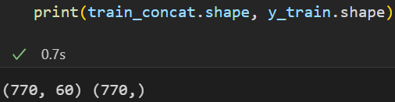
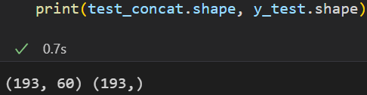
Data Shape
Train Set after Data Preprocessing
And Feature Engineering
Test Set after Data Preprocessing
And Feature Engineering

Slide 14
Modeling
Hyperparameter model with normalize data
Hyperparameter model without normalize data

Slide 15
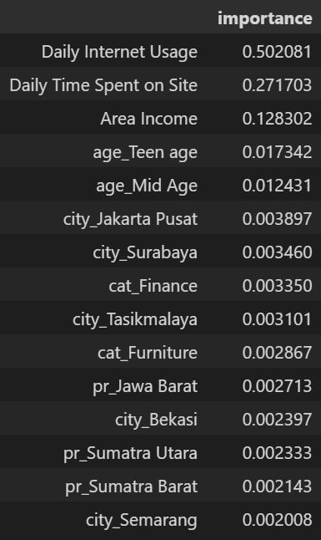
Model Result
There are top 15 feature importance used Randomforest feature importance method. Daily Internet Usage and Daily Time Spent on Site are the top 2 feature with importance score 0.502 and 0.271
Feature importance for model with normalize data

Slide 16
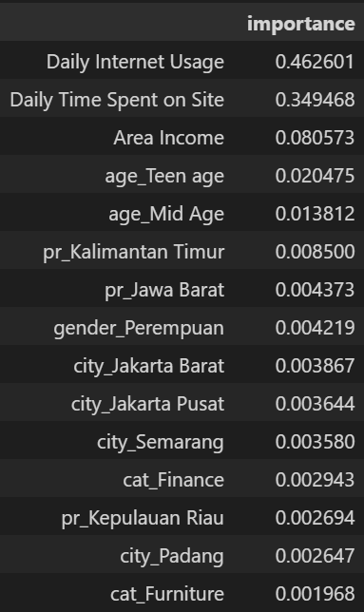
Model Result
There are top 15 feature importance used Randomforest feature importance method. Daily Internet Usage and Daily Time Spent on Site are the top 2 feature with importance score 0.462 and 0.349
Feature importance for model without normalize data

Slide 17
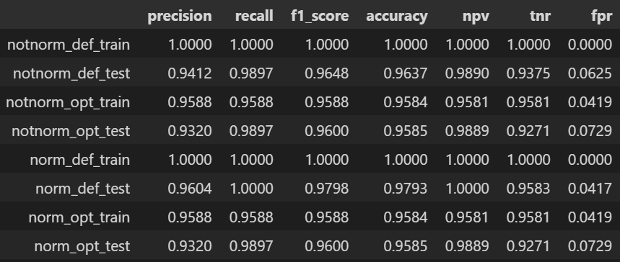
Model Result
MATRIX SCORE FROM RANDOM FOREST MODEL
Description :
notnorm = Data without normalize data
norm = Data with normalize data
Opt = Model with hyperparameter tunning
Def = Model Withput hyperparameter tunning

Slide 18
Model Result
From the table above it can be concluded:
The model with normalized data was chosen, because the FPR value of the data tended to be smaller than the model with data that was not normalized.
2. A tunned random forest model with normalize data chosen.

Slide 19
Bussines Recommendation and Simulation
The conclusion of users who are predicted to click on ads that appear can be described as :
1. Daily time spent on site on average is 52 minutes/day, with a value of q1 = 41 minutes/day, q2 = 50 minutes/day, and q3 = 59 minutes/day
2. Average income area is IDR 337,000,000/year, with a value of q1 = IDR 276,000,000/year, q2 = IDR 337,000,000/year, q3 = IDR 408,000,000/year
3. Average daily internet usage is 130 Gb/day, with a value of q1 = 120 Gb/day, q2 = 135 Gb/day, q3 = 153 Gb/day
4. The eldery age category (>= 45) has a higher percentage of click ads compared to teen age and mid age, which is 88.4%.
5. Gender women have a higher percentage of click ads than men, which is 54.3%.
6. Weekdays have a greater percentage of ad clicks than weekends, which is 52.6%.
7. Balikpapan and Serang have a 100% ad click percentage, besides that East Jakarta has a 76.9% ad click percentage.
8. The bank category has a high percentage of click ads, which is 68.7% followed by Furniture 56.2% and Finance 55%.

Slide 20
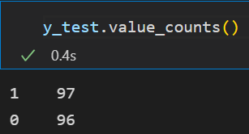
Bussines Recommendation and Simulation
Model Based – Simulation
With machine learning that is made we can make simulations
Assumption
To advertise to a user can use a budget of IDR 15,000. Using test data as a simulation tool about 193 users.
Every user who converts us will get a profit of IDR 17,000.

Slide 21
Bussines Recommendation and Simulation
Without Machine Learning Model:
Cost for Advertisement= 193 * IDR 15.000 = IDR 2.895.000
Convertion rate = 97/(97 + 96) ≈ 50%
Revenue = 97 * IDR 17.000 = IDR 1.649.000
Profit = IDR 1.649.000 - IDR 2.895.000 = - IDR 1.246.000 (NO PROFIT)

Slide 22
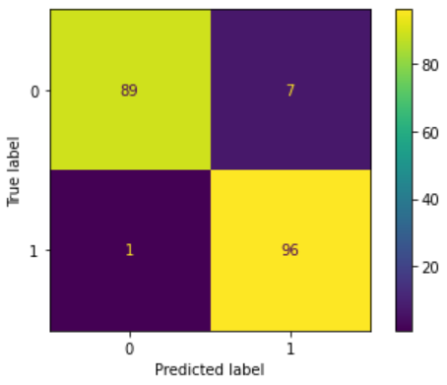
Bussines Recommendation and Simulation
With Machine Learning Model:
Cost for Advertisement= 103 * IDR 15.000 = IDR 1.545.000
Convertion rate = 96/(96 + 7) ≈ 93%
Revenue = 96 * IDR 17.000 = IDR 1.632.000
Profit = IDR 1.632.000 - IDR 1.545.000 = IDR 87.000 (PROFIT)
Based on the simulation above, if we use a machine learning model, we will get a potential revenue of IDR 87.000.
In conclusion, Machine Learning can work well and can even anticipate potential loss into potential revenue.

